Slide 1
Greenpeace Africa: Satellite data analysis reveals Mpumalanga is the worst NO2 pollution hotspot in the world

Slide 2
Greenpeace Africa

Slide 3

Who we are
An independent environmental campaigning organization
We campaign for a just transition away from coal and nuclear and towards renewable energy and energy efficiency
Financial independence
We work in the public interest
Social and environmental justice
We strive for the realization of the constitutional right to a healthy environment

Slide 4
The groundbreaking analysis of satellite data

Slide 5
Greenpeace analysis of satellite data
NO2, and NOx more generally, are dangerous air pollutants, causing respiratory symptoms and lung damage on acute exposure, increasing the risk of chronic diseases in long-term exposure.
The Greenpeace ranking of the worst hotspots of NO2 emissions is based on European Space Agency satellite data, made publicly available but processed and analysed by Greenpeace. Using satellite data gives an objective global view, getting around any issues with under-reporting or misreporting emissions data which is unfortunately common in many countries.
Data became available from 1 June 2018
The analysis is from June to August 2018 (and averages NO2 levels)
Annual or longer term trends may show slightly different results from this three month snapshot of hotspots (weather patterns may change)
The data from the satellite measures the amount of NO2 across the full height of the troposphere (the satellite data is not directly comparable to ground level measurements)
A hotspot is measured with a 25km radius

Slide 6
Our findings

Slide 7
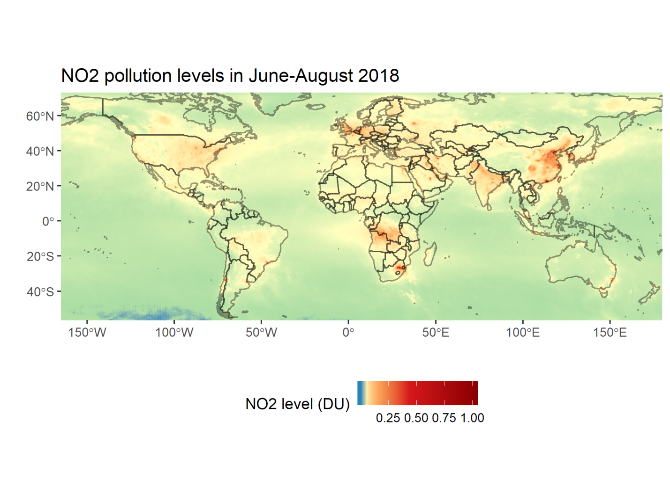
Mapping the biggest NO2 pollution hotspots in the world

Slide 8
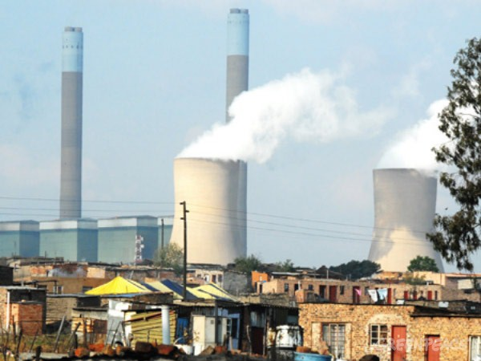
Greenpeace analysis of satellite data
The world’s largest NO2 air pollution hotspot across six continents is Mpumalanga province in South Africa. The province has a cluster of 12 coal fired power stations owned and operated by Eskom, with a capacity of 34 Gigawatts. South Africa therefore has the most polluting cluster of coal-fired power stations in the world.
The analysis points to coal and transport as the two principal sources of emissions. The list of the largest NO2 hotspots in the world includes well known coal-fired power plants in South Africa, Germany and India, and a total of nine coal power and industrial clusters in China. Cities such as Santiago de Chile, London, Paris, Dubai and Tehran also feature high in the ranking due to transport-related emissions.

Slide 9
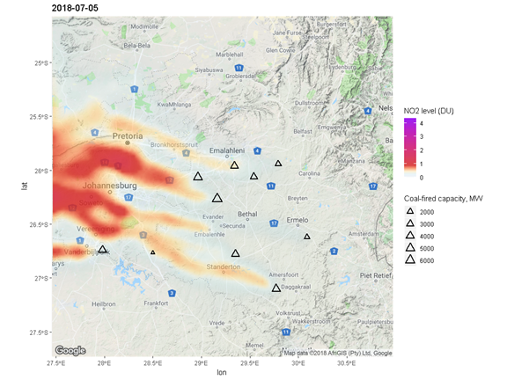
Johannesburg and Pretoria also affected

Slide 10
Why is Mpumalanga so bad?
Mpumalanga, the second smallest province in South Africa, with a population of about 4.5 million people has the highest levels of NO2 globally. This is because the province has the World’s biggest and most concentrated coal cluster. Mpumalanga accounts for 83% of South Africa’s coal production.
12 old, highly polluting coal-fired power stations within a 25 km radius
Overall NO2 emissions in China are higher, but in terms of individual clusters, none of the Chinese emission hotspots are as large as Mpumalanga. This is largely because Chinese power plants and factories have installed emission control devices, while Eskom continues to seek postponements from complying with weak Minimum Emission Standards.

Slide 11
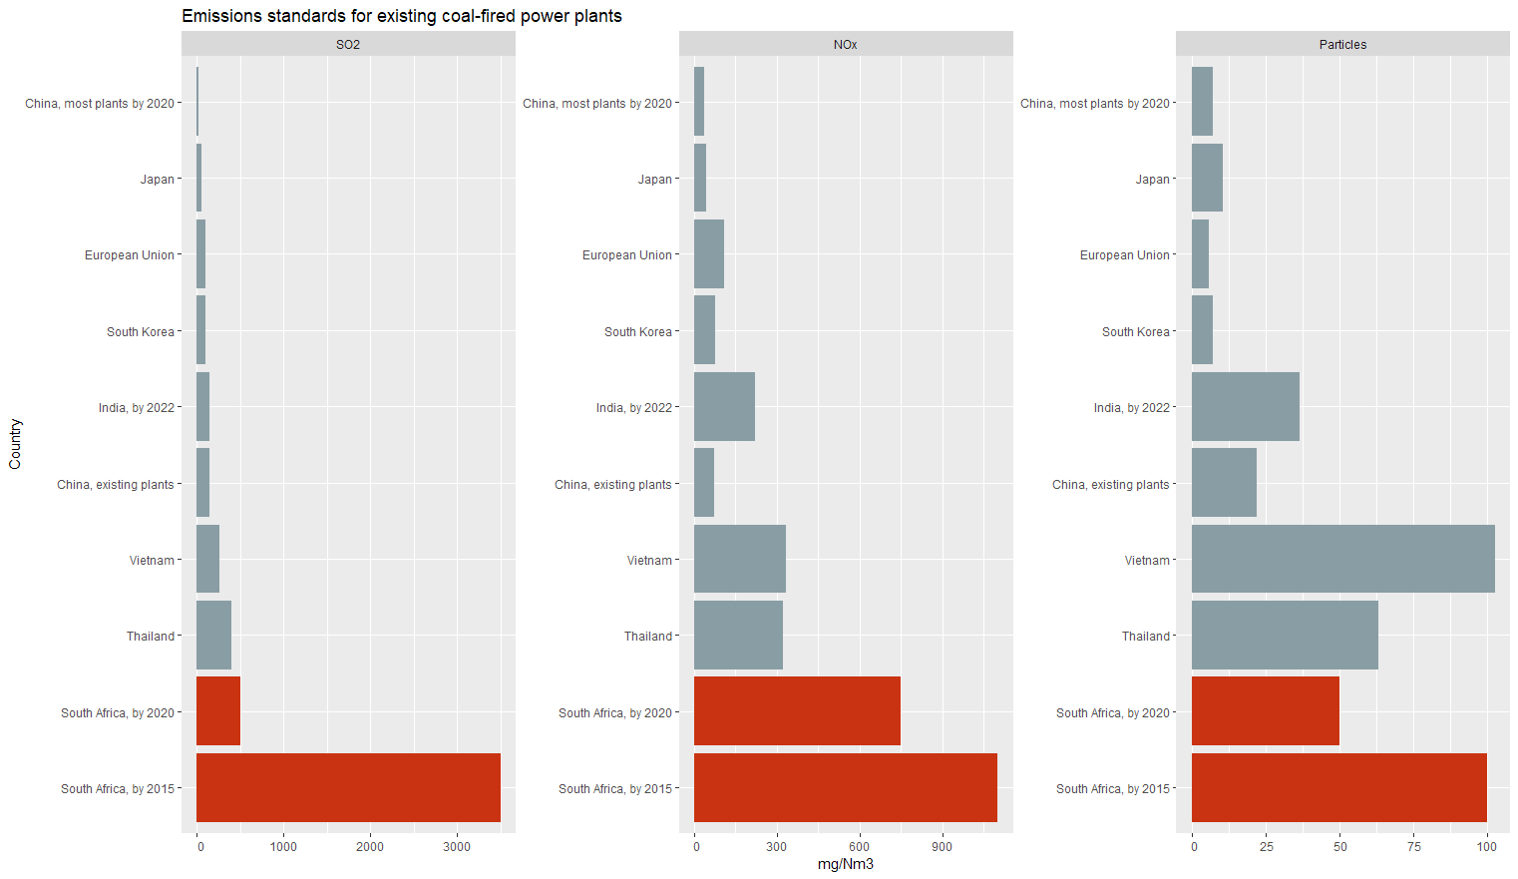
Weak Minimum Emission Standards

Slide 12
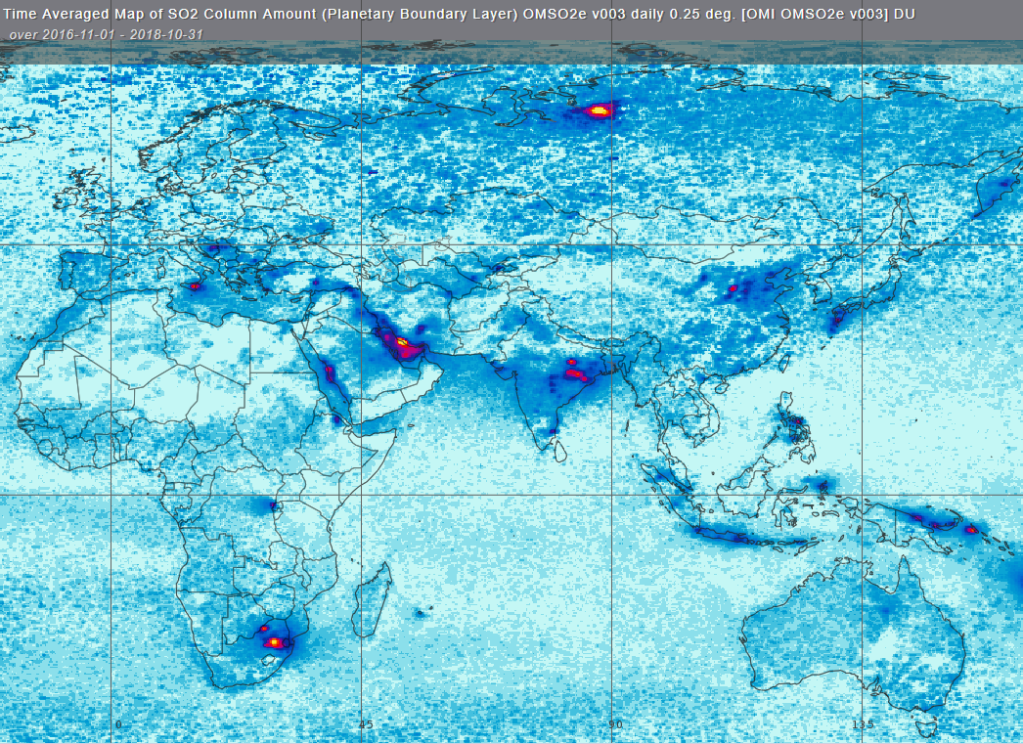
We analysed NO2, but what about SO2?

Slide 13
Weakening of SO2 standards?
The Department of Environmental Affairs has decided to unlawfully weaken SO2 emission standards for coal-fired power stations.
In October 2018, the department’s updated framework for Air Quality Management, significantly weakened the minimum emission standards. The MES for new installations was originally set at 500mg/m³, but these MES were revised by the Department upwards to 1000mg/m³, which is 30 times more than coal-fired power stations are allowed to emit in China.
This revision was not part of the original public participation proposal and is therefore undemocratic and unlawful.
Greenpeace calls on the DEA to withdraw this weakening of the MES with immediate effect.

Slide 14
Greenpeace Africa demands
Absolutely no further postponements from complying with Minimum Emission Standards for Eskom’s coal-fired power stations in South Africa can be granted. If coal-fired power stations don’t comply, they need to be decommissioned.
An Air pollution action plan for Mpumalanga, Johannesburg, Pretoria and all other high priority areas, that:
  follows the guidelines and maximum air pollution levels of the World Health Organization (WHO) and international emission standards for coal-fired power stations
  sets up concrete measures and steps to improve the air pollution levels in those regions and makes sure that they comply with the air pollution standards within 5 years
  introduces independent, regular and reliable air pollution monitoring, which is available to the public and informs decision-making (including transparent data)
No new coal-fired power stations in the national electricity plan (IRP 2018), the cancellation of unit 5 and 6 in Kusile coal power plant in Mpumalanga and the decommissioning of 50 percent of current coal-fired power stations by 2030 in line with the latest Intergovernmental Panel on Climate Change (IPCC) Special Report on 1.5°C.

Slide 15
Melita Steele msteele@greenpeace.org
&
Happy Khambule hkhambul@greenpeace.org

